Slide 1
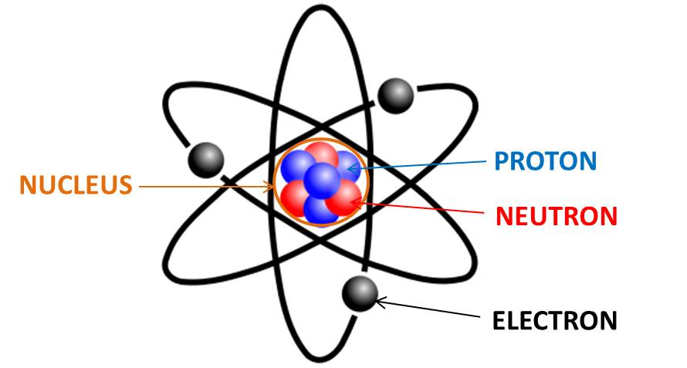
Lesson C2 – The Atomic Theory
https://energywavetheory.com/wp-content/uploads/2016/09/atoms.jpg

Slide 2
kinetic molecular theory (KMT): explains how particles move in different states
atomic theory: provides evidence for the existence of atoms and molecules

Slide 3
Democritus (460 – 370 BC) & Aristotle (385 – 323 BC)
Democritus proposed the idea that matter was made up of tiny particles that exist in empty space.
Aristotle disagreed with Democritus’ ideas because he did not believe that empty space could exist.

Slide 4
John Dalton (1766 – 1844)
Dalton observed how matter combined and broke down in regular ratios.
In 1805, he published a modern atomic theory and supported it with scientific observations. It was accepted by scientists of the time.

Slide 5
Dalton’s Atomic Theory
All matter is made of extremely small particles called atoms.
Atoms cannot be created, destroyed, or divided.
All atoms of the same element are identical in size, mass, and chemical properties. Atoms of a specific element are different from those of another element.
Different atoms combine in simple whole-number ratios to form compounds. In a chemical reaction, atoms are separated, combined, or rearranged.

Slide 6
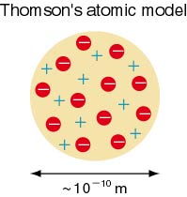
Joseph John (J.J.) Thomson (1856 – 1940)
Discovered the electron in 1897, leading to his proposing the chocolate chip cookie model of the atom:
Negatively charged electrons are like chocolate chips, suspended in the positively charged “cookie crust” of each atom

Slide 7
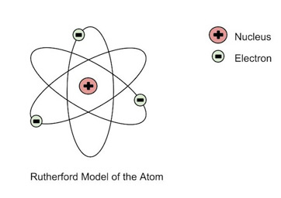
Ernest Rutherford (1871 – 1937)
Performed the famous gold foil experiment in 1909.
Led to the development of the concept of a nucleus: a dense core of positive charge with the negative electrons moving around it.

Slide 8
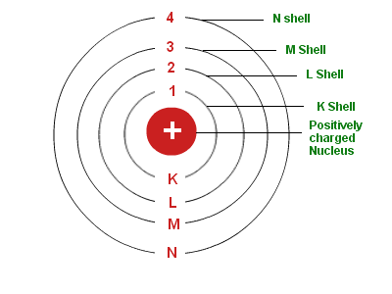
Niels Bohr (1885 – 1962)
1913: applied quantum theory to come up with the model of the electrons only being found in specific orbitals around the atom. This model explained how specific amounts of energy are absorbed and emitted by different elements.

Slide 9
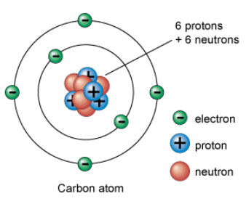
James Chadwick (1891 – 1974)
Discovered the neutron in 1932.
The neutron is an uncharged particle of equal mass to a proton.
The neutrons were added to the protons in the nucleus of the atom
The Bohr model became popular for explaining the behavior of matter and elements in chemistry

Slide 10
Schrodinger & Heisenberg
In 1925, Schrodinger came up with wave mechanics, describing the parts of the atom as interacting like a wave.
In 1926, Heisenberg applied mathematics to prove that an electron’s position and velocity could not be identified at the same time.
The two ideas combined to create the electron cloud model of the atom. The nucleus stayed the same, but clouds were used to show you where you have a higher probability of finding electrons.

Slide 11
The standard model
In the second half of the 20th century, further discoveries, and the explanations for those discoveries, have led to the development of the standard model.
The standard model explains that:
protons are made of 3 smaller particles called quarks
Neutrons are made of 3 smaller particles called quarks
Electrons are one type of lepton

Slide 12
Atomic Theory
Clearly, the atomic theory is more complex today, and while it answers many questions about the universe, it is still incomplete.
It cannot answer Big questions about Dark Matter and Antimatter in the formation of the Universe.

